Slide 1
Ci/CD web project
Chalenko Andrey

Slide 2
Task project
Create git repository
provide a comfortable and quick change on the server
Building and testing web project

Slide 3



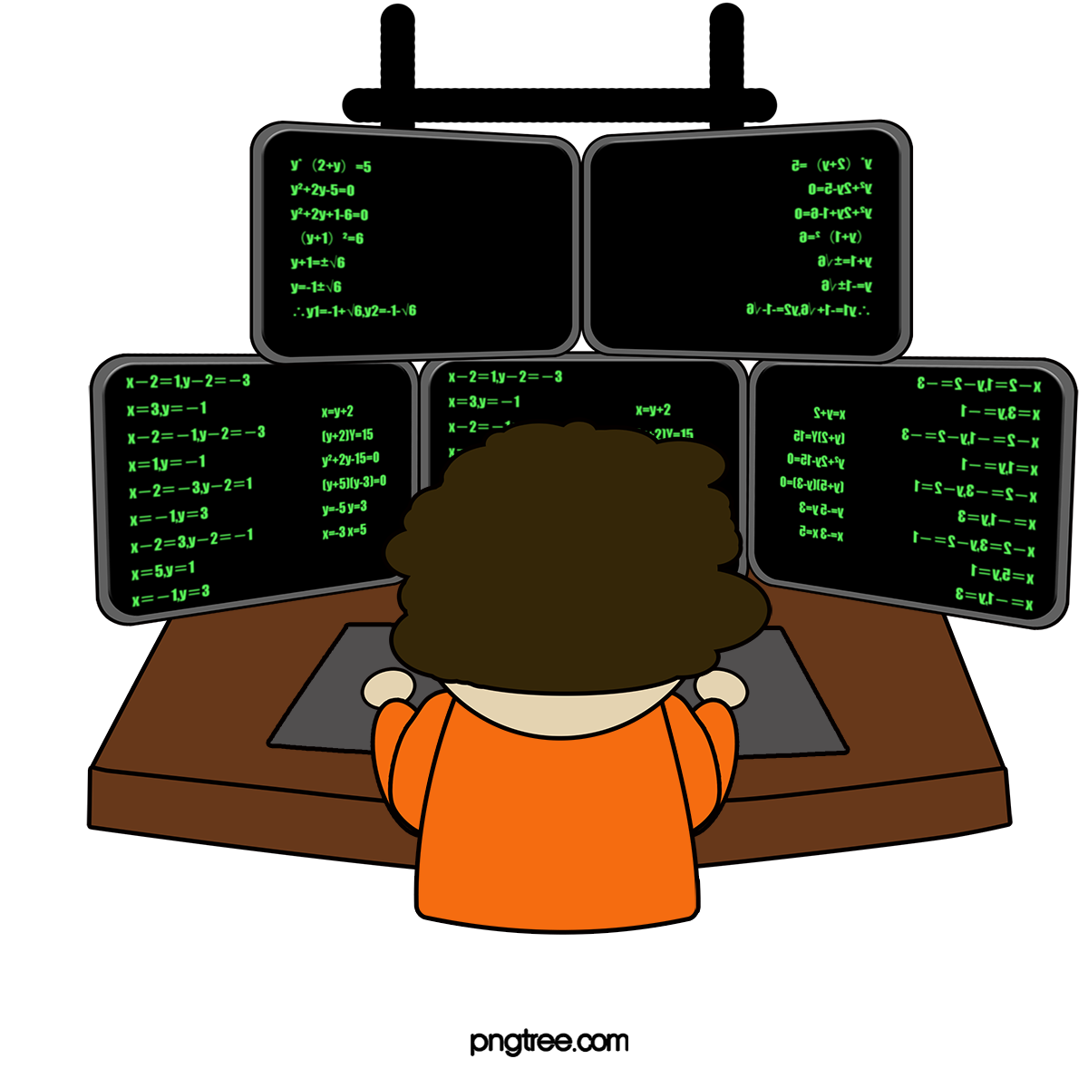

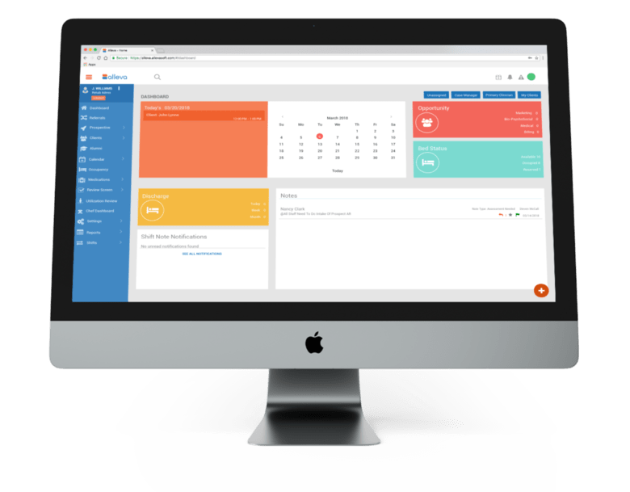
What the system looks like
Shell script
Web hook
Web site
Git push
View

Slide 4
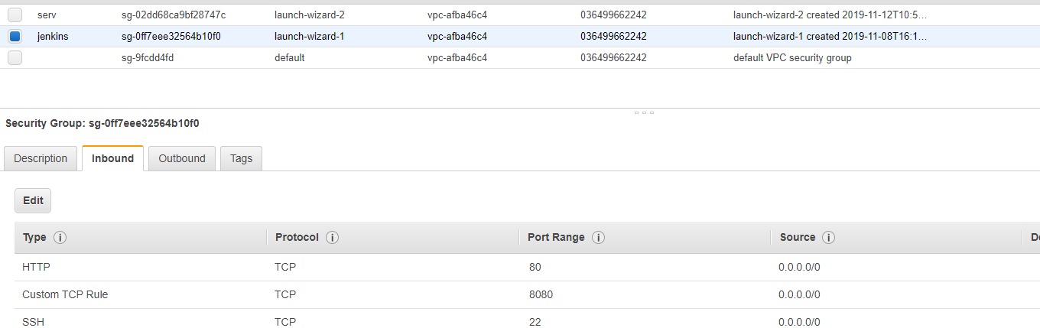
Configure AWS
Created Instance
Created Security Group

Slide 5
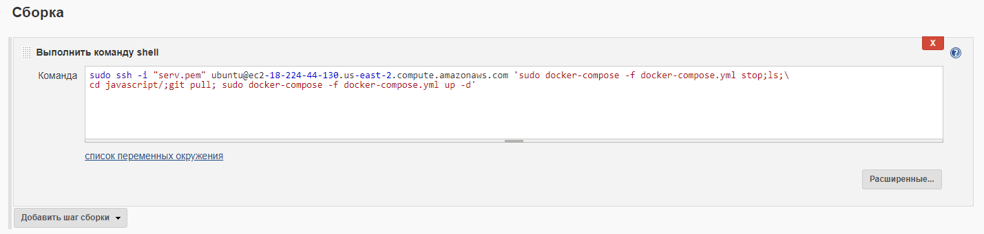
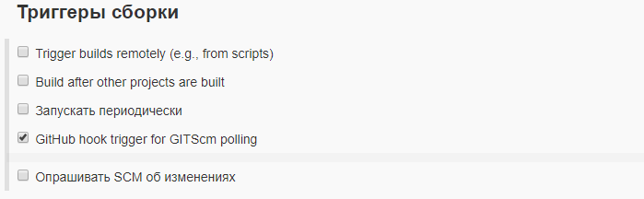
Config jenkins
Build script
Build trigger

Slide 6
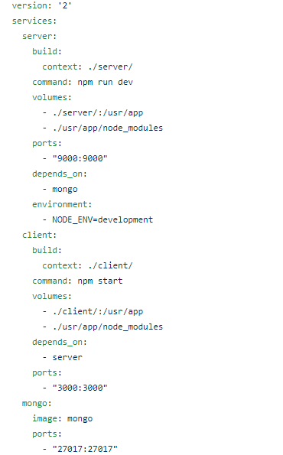
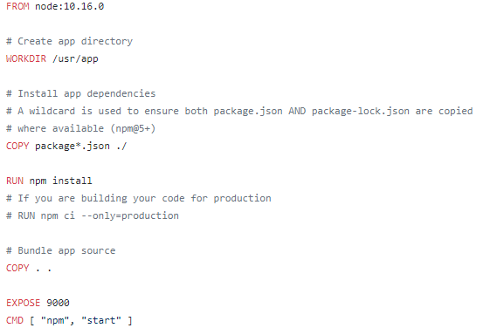
Docker Compose
Dockerfile server

Slide 7
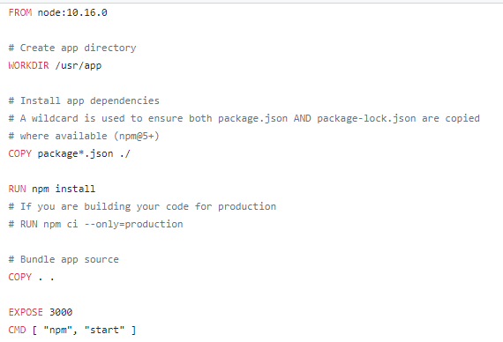
Dockerfile client

Slide 8
Thanks for attention

